Slide 1
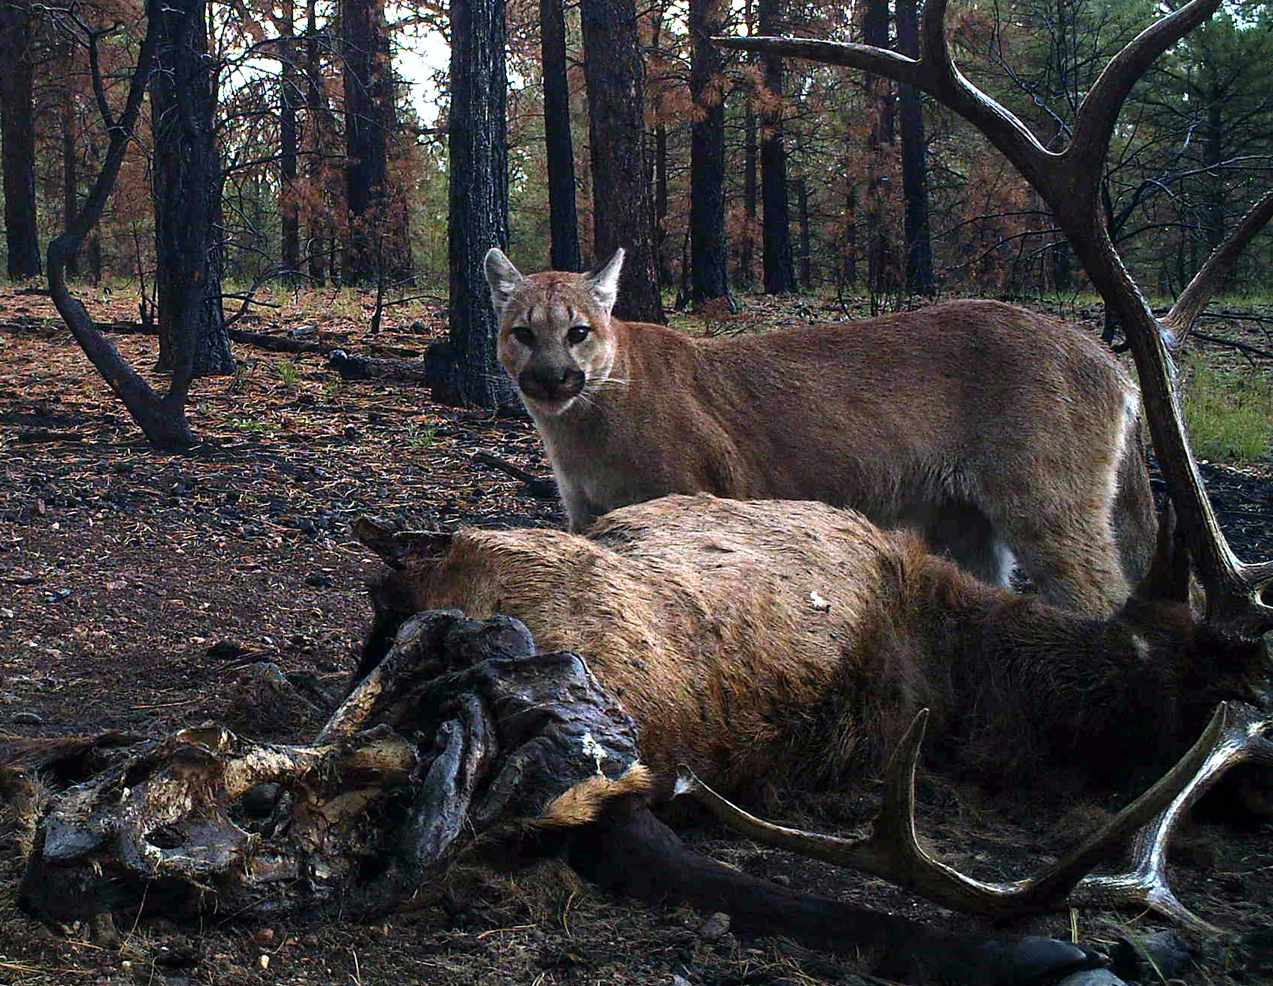
Sexton, Nagol, Stoner, Ironside, Mattson

Slide 2


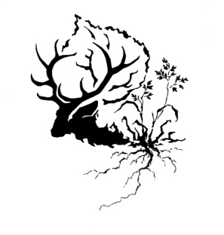







Plants, Prey & Predators:
Macroscopic observations of plant phenology and animal movement in the Western United States
Joseph O. Sexton¹, Jyotheshwar Nagol¹, David Stoner², Kirsten Ironside³, Thomas Edwards⁴, and David Mattson³
¹Global Land Cover Facility, University of Maryland
²Utah State University
³USGS Southwest Biological Science Center & Northern Arizona University
⁴USGS Utah Cooperative Fish and Wildlife Research Unit

Slide 3











Acknowledgements
Funding
  NASA Climate & Biological Response Program
  Hogle Zoo
Facilities
  GLCF, UMD
  USGS F&W Coop Unit, USU
  USGS NAU
Collaborators
  Kathleen Longshore
  David Choate
  Fernando Colchero, Max Planck Demographic Institute
  Sean McMahon, SERC
  Dean Urban, Duke University
Data providers

Slide 4
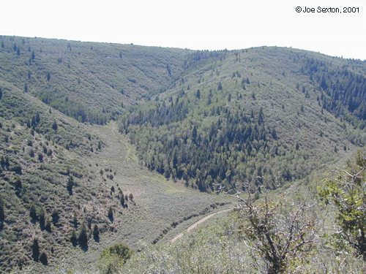
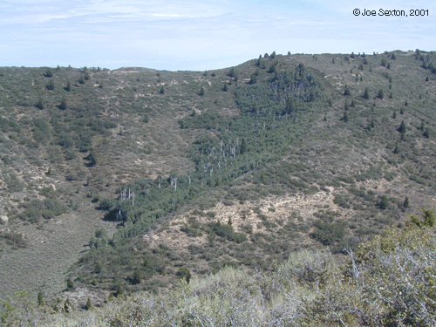
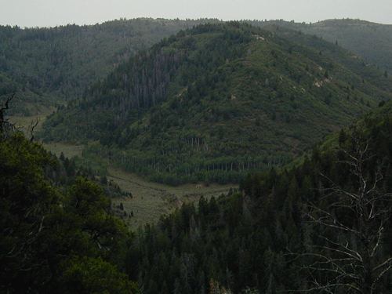
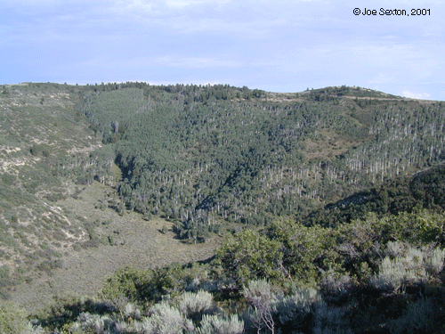
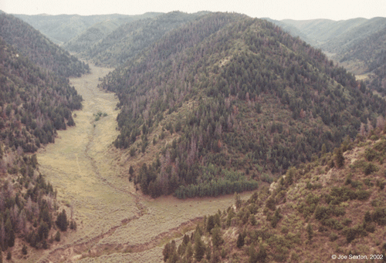

Slide 5
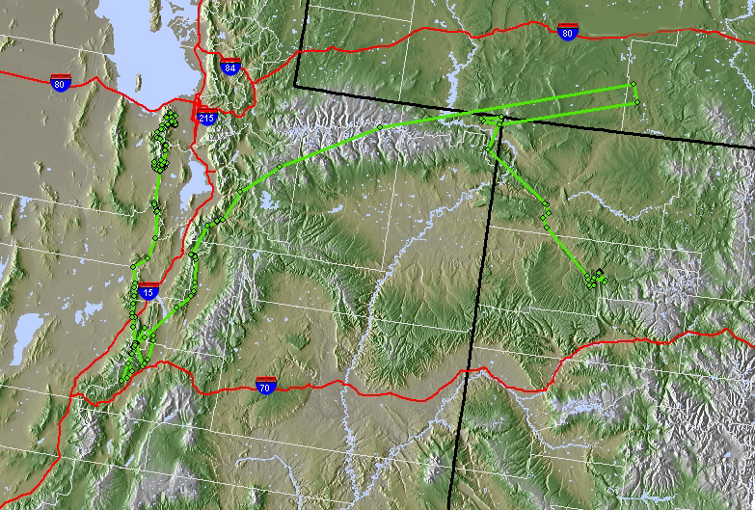
F31 Dispersal: SLC, UT to Meeker, CO
February 9, 2005 to February 8, 2006
WY
10/2/05
Capture: 2/9/05
5/6/05 left Oquirrhs
9/4/05 crossed Uintas
11/28/05
Death: 2/8/06
7/5/05 turned north
CO
UT
200 km
M. Wolfe, D. Stoner, and W. Rieth, Dept WR, Utah State University
Notes:
Average movement distance is ~3 km/d.
This FEMALE approximately doubled that, and was extremely directional in her movements.
Shows how little we know about macroscopic behaviors of terrestrial animals – even our own well-studied back yards.

Slide 6
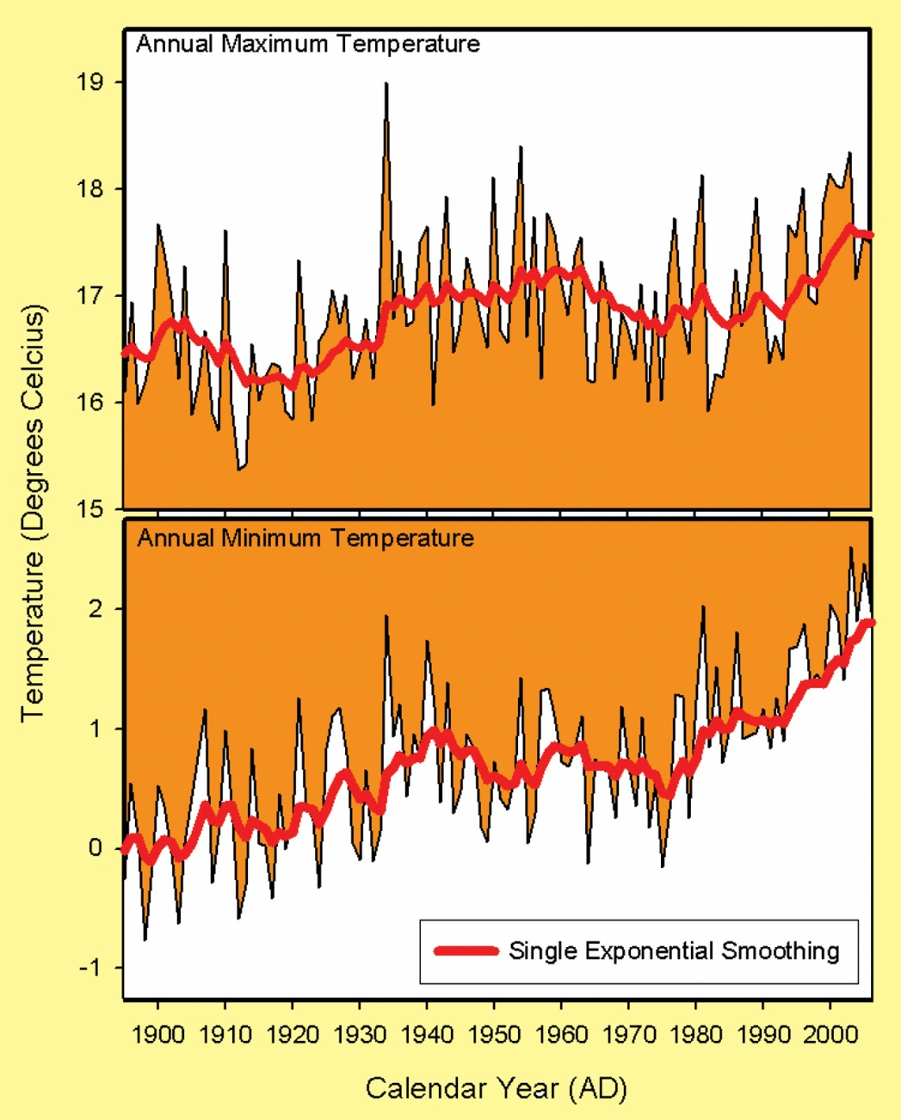
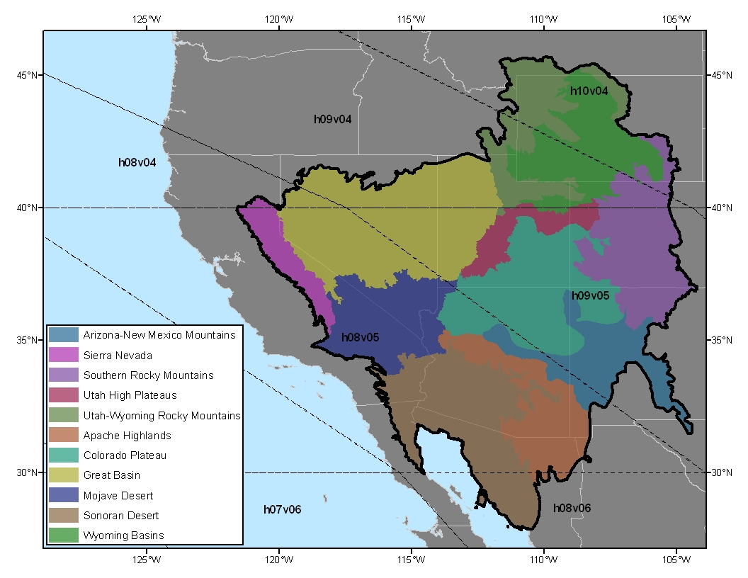
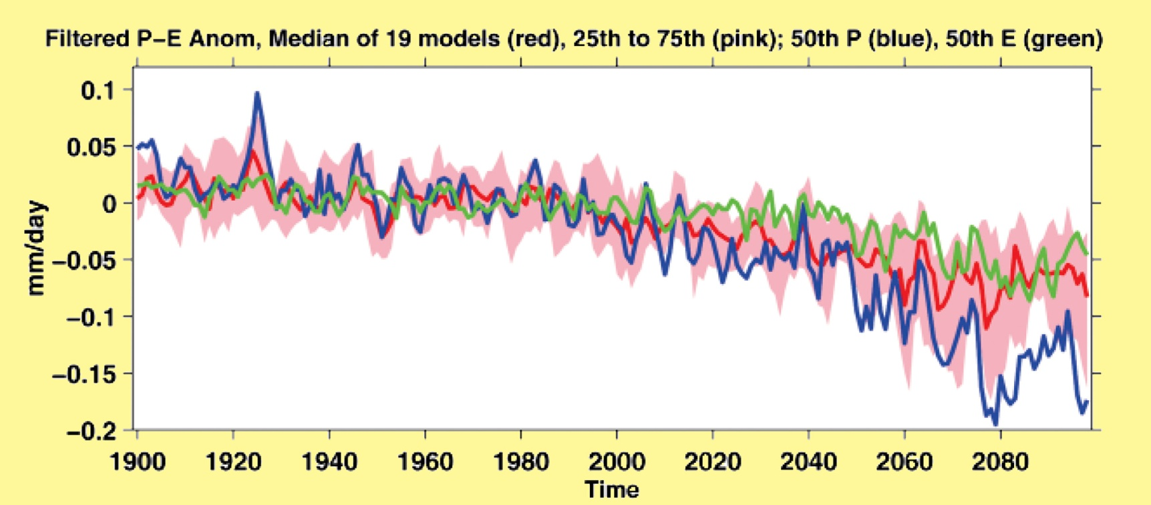
Notes:
Climate change is particularly relevant in this largely arid region because substantial warming has already occurred, with more to come…
This figure shows average maximum and minimum temperatures on the Colorado Plateau, with dramatic warming evident since c. 1980. …Accompanied by substantial forecasted drying. This figure shows projected drying in terms of deviation of ppt-evaporation from the current mean. Drying is projected to accelerate after c. 2040.

Slide 7
Guiding Questions
How does climate affect vegetation phenology?
How do climate and vegetation affect ungulate habitat selection and demographics?
How do climate, vegetation, and prey affect carnivore habitat selection and demographics?

Slide 8
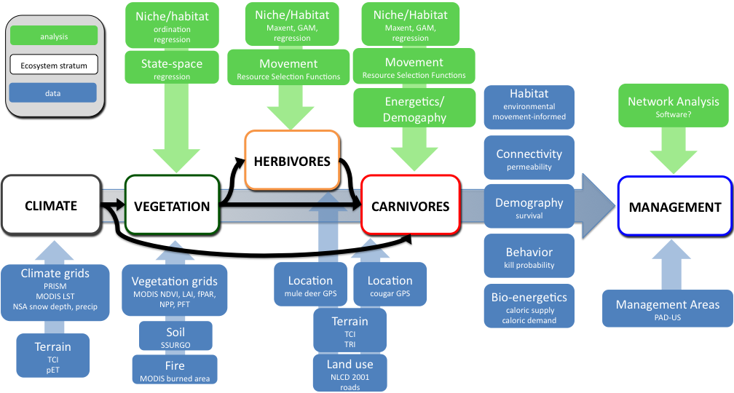
Linear, Modular Approach
Process diagram
Feedbacks recognized , but not addressed explicitly

Slide 9
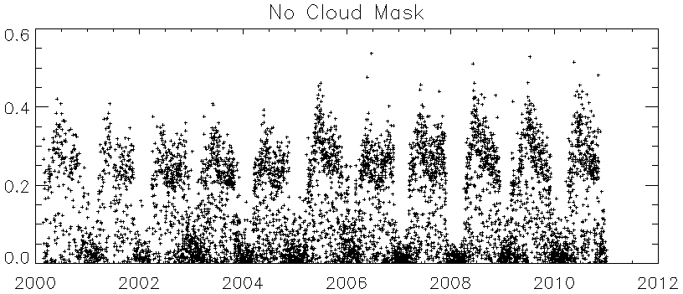
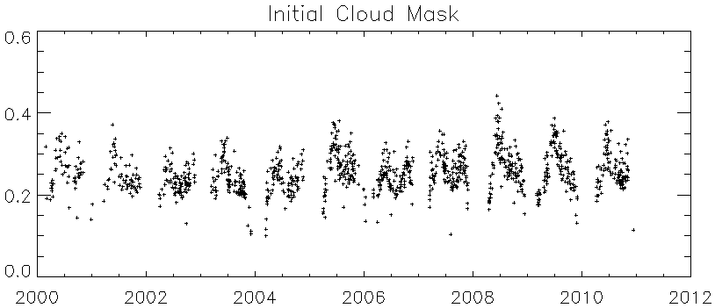
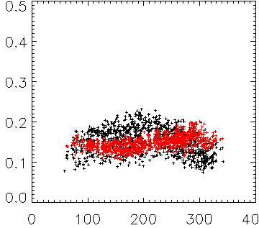
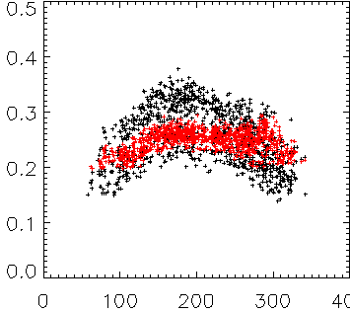
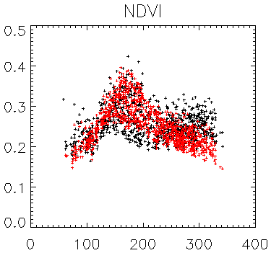

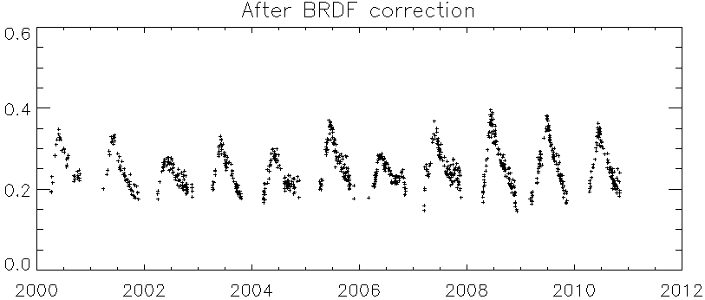
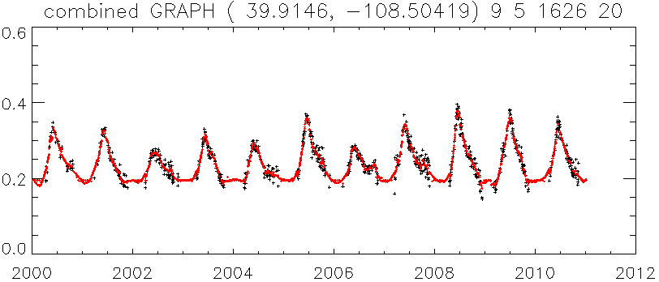
1. MODIS Data
- MOD09GA Aqua/Terra
(2000 to 2010)
- 500m resolution
Raw MODIS NDVI Data
NDVI
Years
BRDF Correction
2. Initial Cloud Mask
- MODIS QA flags were used
- Data were masked for:
- Cloud, Cloud Shadow, Cirrus Cloud
- High Aerosol
- SZA < 70 and VZA < 50
Initial Cloud Mask
Red
NIR
NDVI
NDVI
Black: No BRDF correction
Red: BRDF corrected
Day of Year
Day of Year
Day of Year
Years
3. Advanced Cloud Mask
Residual cloud- and snow-covered pixels removed by
  generic BRDF correction.
  rolling window outlier removal in red and NIR
Advanced Cloud Mask
NDVI
Years
After BRDF Correction
4. BRDF Correction
- Ross-Li-Maignan model.
- BRDF parameters inverted in each month
- Vegetation structure assumed constant over time.
NDVI
Years
5. Gap-Fill / Interpolation
- Nearest neighbor for winter gap
- Moving window cubic polynomial fit
Gap-Fill / Interpolation
NDVI
Years

Slide 10
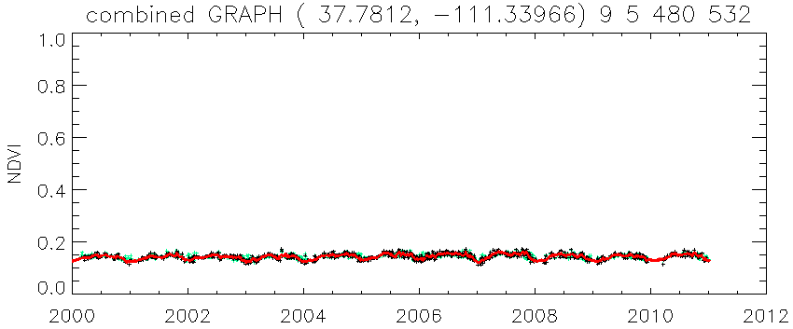
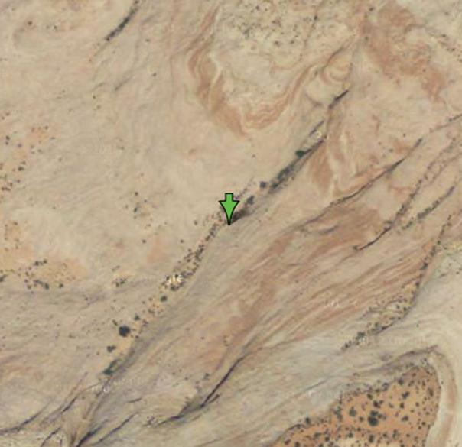
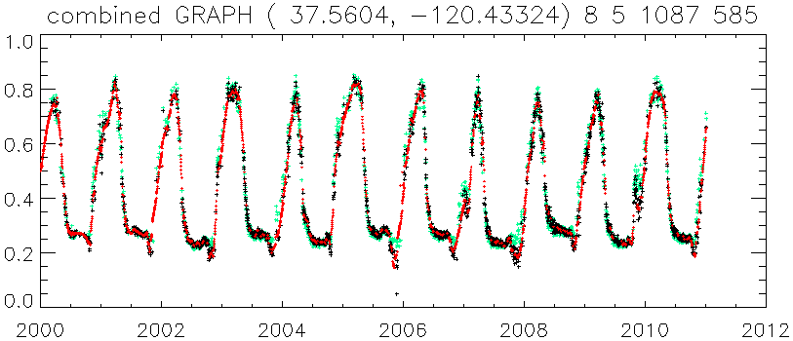
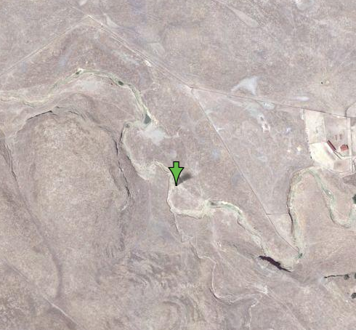
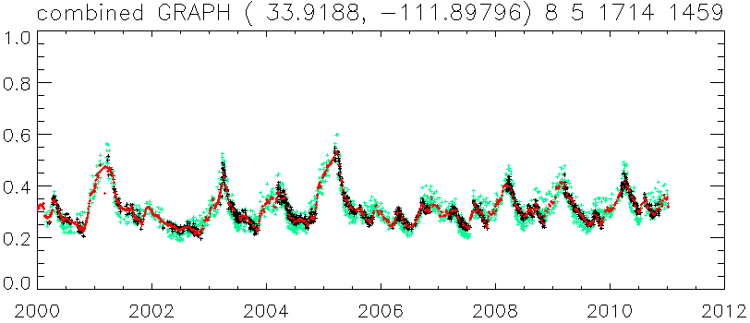
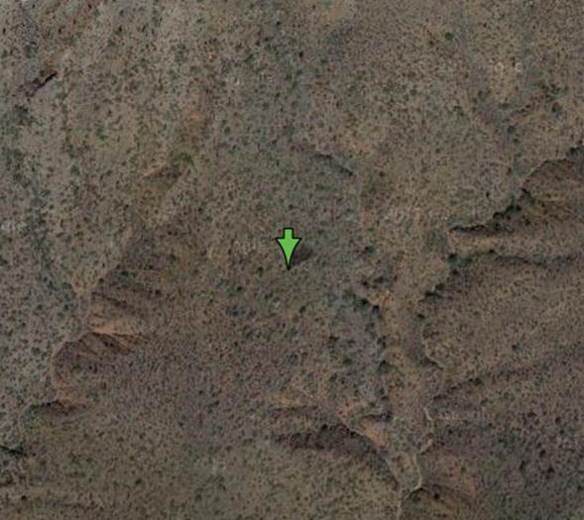
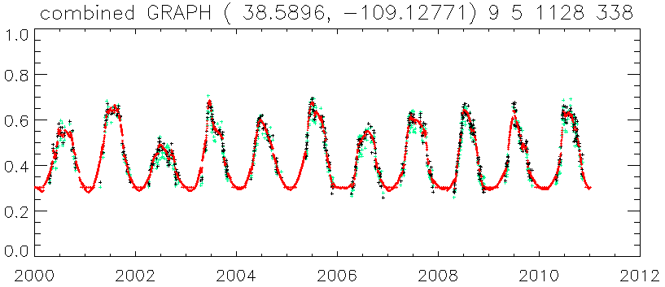
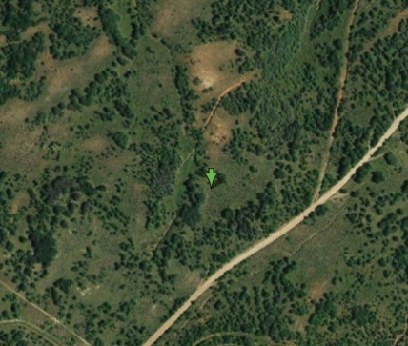

Plants
Desert
(17.7812, -111.3397)
Grassland
(35.5604, -120.4332)
Shrubland
(33.9188, -111.8980)
NDVI
Mixed forest
(38.5896, -109.1277)
Years
NDVI
NDVI
Years

Slide 11
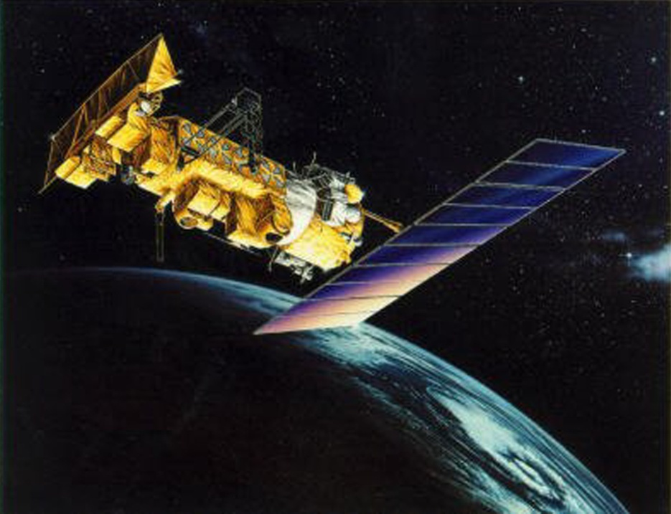
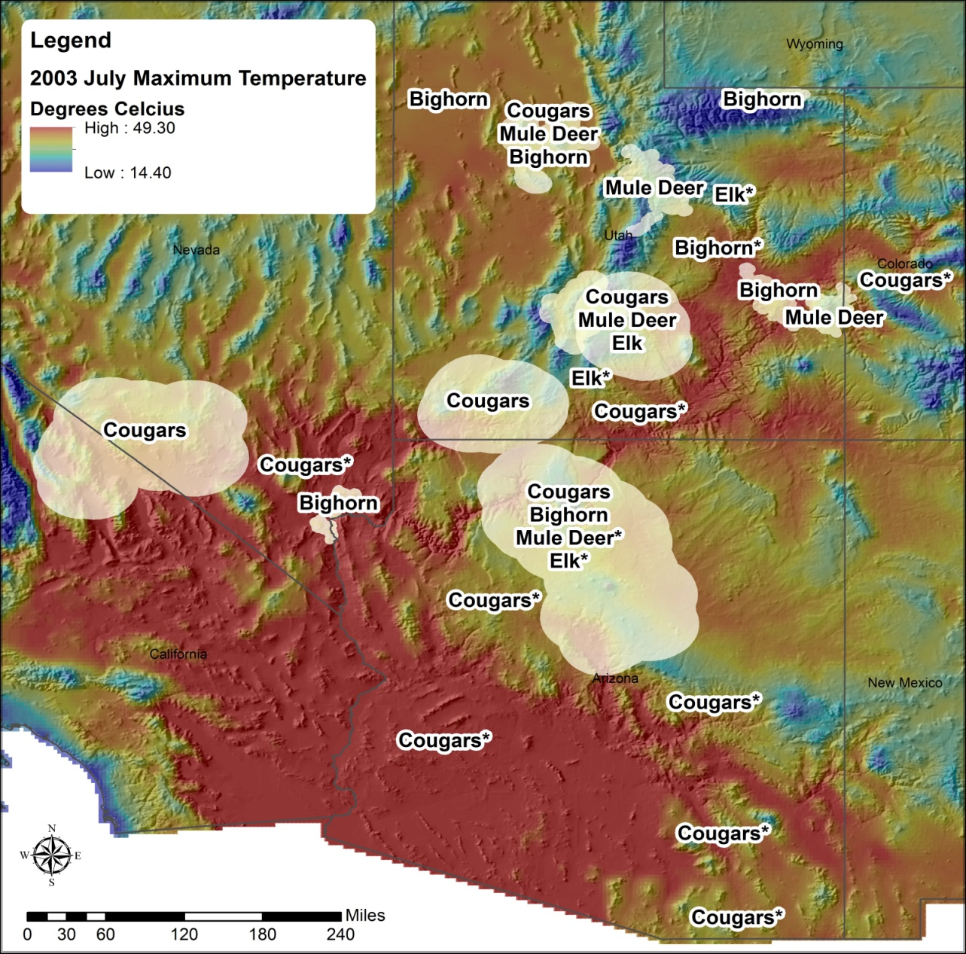
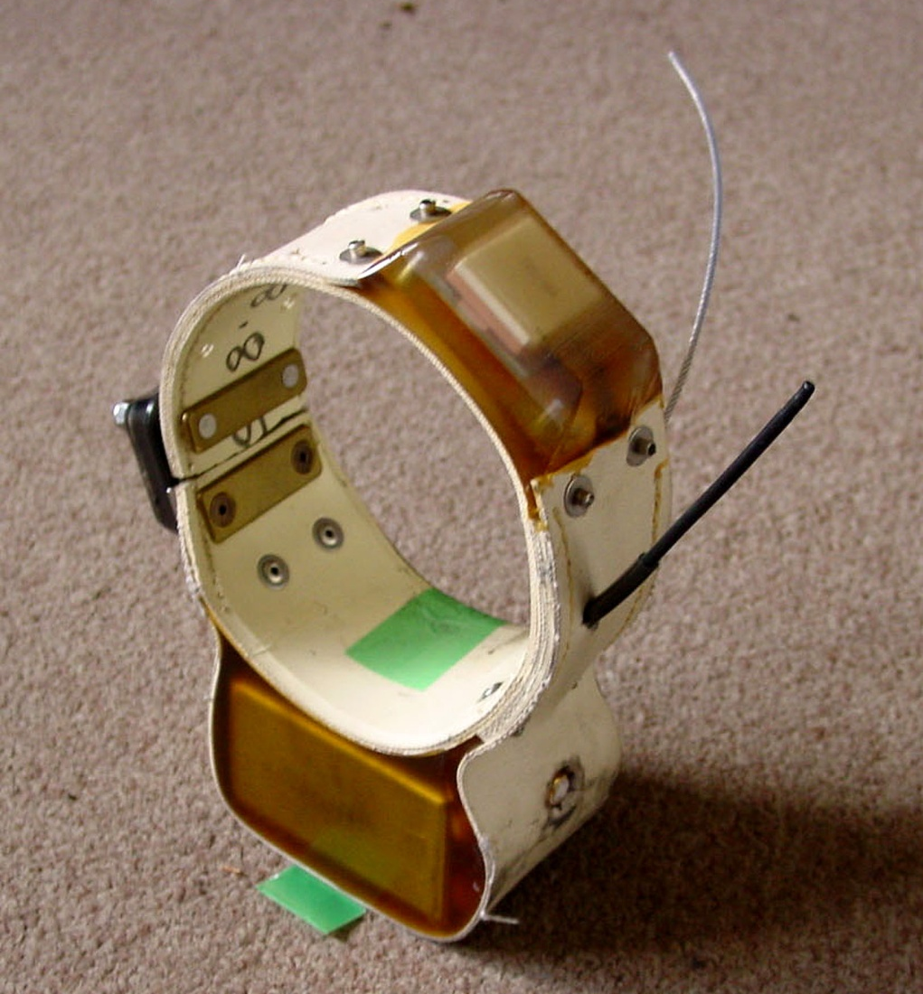
Cougar: 79
Mule deer: 117
Bighorn sheep: 89
Elk: 30

Slide 12
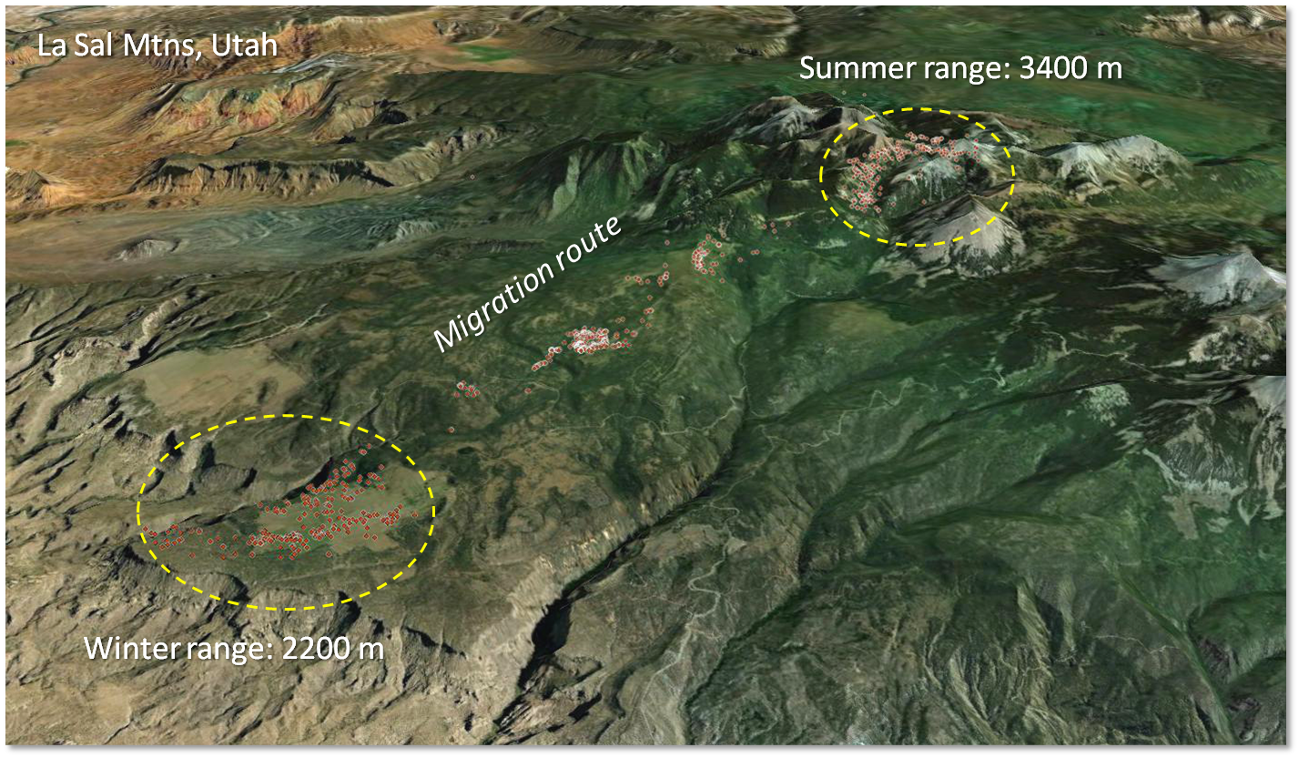
Notes:
Clear migration pattern between winter and summer range. Case closed.

Slide 13
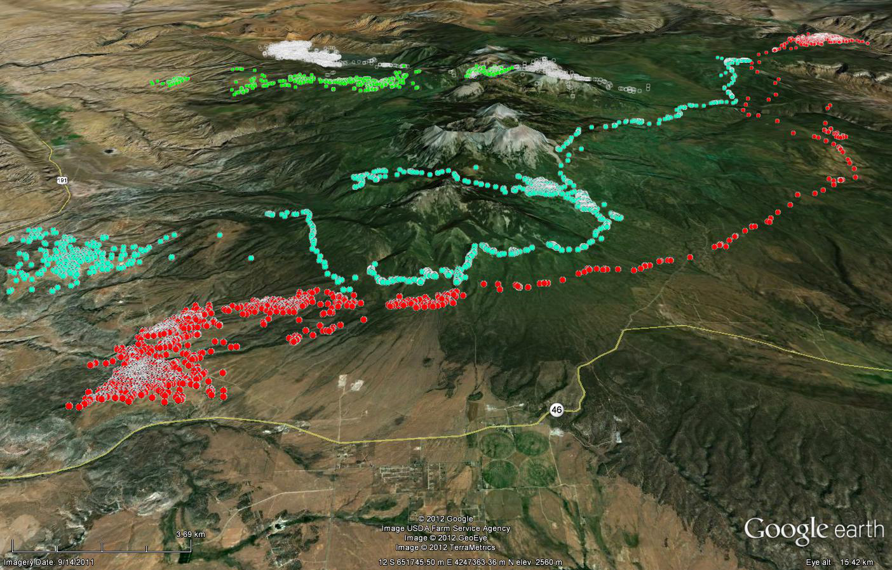
Notes:
But very wide variability between animals! So not so simple.

Slide 14
Notes:
Lower productivity in La Sal
Tighter vegetation selection in herbivore.

Slide 15
Conclusions Assumptions
Coincident, relevant observations are key
  Application is validation
  Bring outreach in
If you build it, they will come
  If it stays in NASA, we will have failed
  from black hole to supernova

Slide 16
Next steps
Plants
  Endmember extraction
  Phenological norms & anomalies
  Climate correlations
  Structure? Succession/disturbance?
Prey
  NDVI correlations
  Habitat & movement
  Forage (NDVI) quality? Predator feedback?
Predators
  Demography (BaSTA)
  Movement
    Movebank (Bohrer et al.)
    Marine Geospatial Ecology Tools (MGET; Halpin et al.)

Slide 17
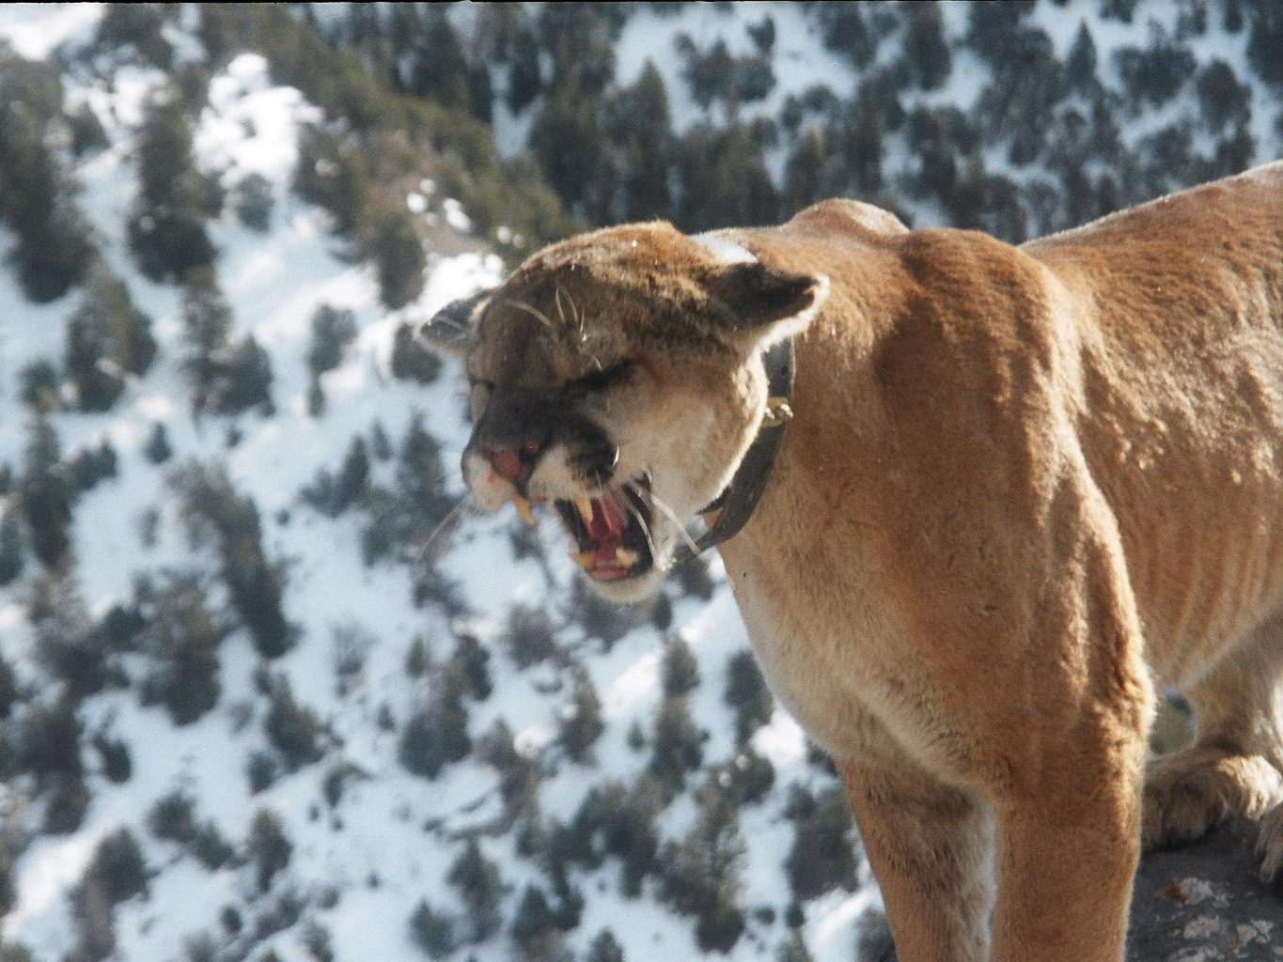
Questions?

Slide 18
Questions
    What are the spatial, demographic, and energetic responses of terrestrial vertebrates to climate?
    How do climate effects transmit through the trophic chain?
Approach
    Model movement, survival, energetics, and connectivity of large mammals on the Colorado Plateau using GPS telemetry, satellite measurements of vegetation, and climate datasets.
Key elements
    Large database of herbivore and carnivore locations spanning 10 years of vegetation phenology measurements from MODIS.
    Quantify and propagate uncertainty between trophic levels with hierarchical Bayesian models.
    Assess habitat connectivity through graph-theoretic analyses.
Near-term efforts
    Wavelet analysis of animal movements; comparison of terrain roughness indices; environmental gradient analysis of cougar diet and related prey responses

Slide 19
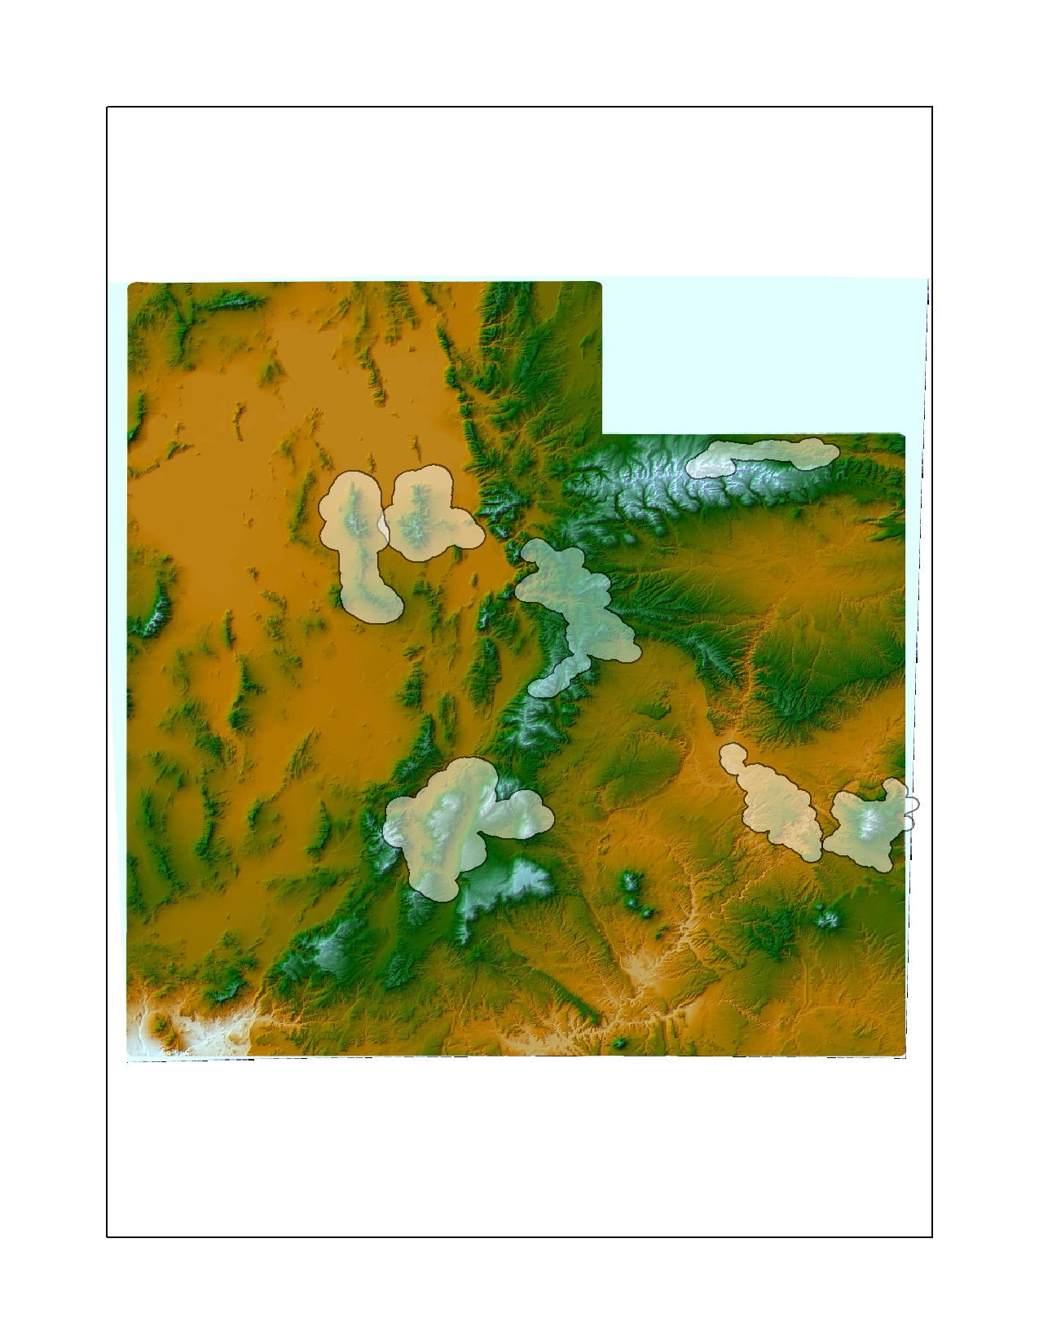
Stars denote site where GPS collars are currently deployed on elk (red) and bighorn sheep (beige), that may be available in 2014.
Oquirrh Mtns: 29 cougars; 15 deer
Uinta Mtns: 12 sheep
Stansbury Mtns: 3 cougars; 6 sheep
Wasatch Mtns: 31 deer
Figure 1. Current and projected number of GPS datasets.
La Sal Mtns: 54 deer
Monroe Mtn: 6 cougars; 17 deer; 1 elk
Canyonlands: 24 sheep

